Slide 1
LION Conflation Process
Draft/Preliminary
April 2020

Slide 2
Introduction
A lot of our geographic data is mapped to the latest version of LION of the previous year
In 2019 some our data was mapped to LION 18D
Every year once the latest quarter version of LION is released, we remap to that version (i.e. current year – 1 D) so that our data is never stuck on an outdated version of LION
Data that we need to migrate;
SIP Projects + Treatments
VZP
Speed Limits
Bike Lanes

Slide 3
How the process works
A separate part of DOT works on compiling LION changes from DCP; in other words how segments have changed from past versions to the present
Segments merge/split
Roadbeds become divided into 2
New streets are added
Closed streets (i.e. Ped Plazas) are removed
We use this change file to try to “migrate” or translate our datasets’ segments and nodes from the old version to the new version
Note: we translate each dataset using the main conflation table because the type of data we’re translating matters; bike lanes on a newly divided roadbeds might not have to be remapped to both roadbeds, speed limits probably do
There are some issues with this process…

Slide 4
How the process works
Issues
Older segments are not found in the change file
New segments don’t have and old counterpart
Segments attributes change from what we would consider “valid” (a real roadbed) to not and vice versa
Closed streets (i.e. Ped Plazas) are removed
Mistakes in LION change file
i.e. segmentid is said to have split into 2 segments, but a third one exists on the MFT
…For all of these issues we do manual review to make sure there aren’t any mistakes, omissions, false positives, etc.

Slide 5
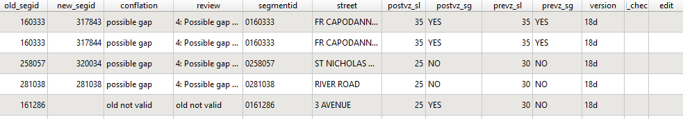
Manual Review
Conflation produces a shapefile output for review, mapped to the new LION (19D) geometry
Use “Conflation” field to identify errors and “Review” for potential error details
Use “Edit” field to give direction on how to handle error
Only field to change
Old ID
Data from original table (Speed Limits)
New ID
Conflation status
Issue detail

Slide 6
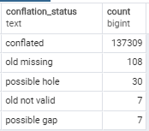
Manual Review
Conflation types
Conflated = no issues in conflation (that we know of)
Old missing = no new match for an old segmentid (e.g. closed street)
New missing = new segmentid exists without an old predecessor (e.g. new street)
Old not valid = the segmentid in our dataset was not a real roadbed, did we make a mistake?
Possible gap = any number of issues with validity not matching up across versions, likely not a real match
Possible hole = the dataset being migrated has a new LION segment between 2 conflated segments, are we sure it’s not supposed to be in the dataset?

Slide 7
Manual Review
Possible “Edit” field actions
Edit field tells us how to proceed with conflation, please only use one of the following, if you find some other issue, let’s discuss it;
"delete" = delete this record, it’s not a real hole or issue was fixed in a different record
"conflated" = good record, this guess at the correct conflation was correct, keep it
“new" = this was copy-pasted from the new LION version, as a fix to some issue
"use old geom" = this is when segment has been retired from lion (i.e. plaza) but we still want to keep it, let’s talk before you add this

Slide 8
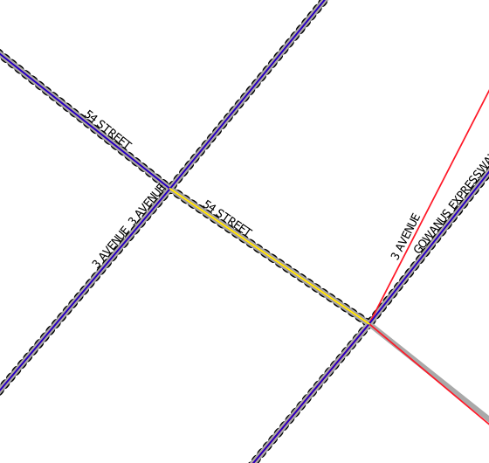
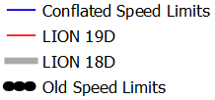
Examples
Old Missing
The highlighted portion seems to not have a new match.
I checked the segment in the old LION and in the new; in the new it changed to rb_layer to Generic; should be “Both”!
This looks like a mistake in LION, we still want to keep the segment
EDIT = ‘conflated’

Slide 9
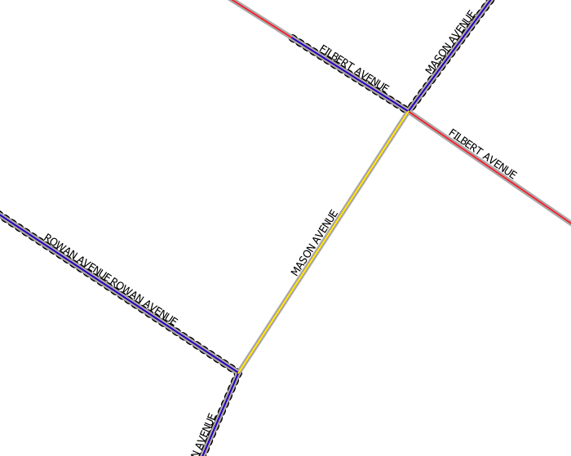
Examples
Possible Hole
There is a segment between 2 conflated segments that was not conflated
In this case Mason Avenue had a speed limit between on either side but in the speed limits file it did not exist, was this a possible past mistake?
Actually, it’s a paper street in LION and if you look at google street view, you’ll see there’s a creek that runs between Rowan and Filbert Av.
EDIT = ‘delete’

Slide 10
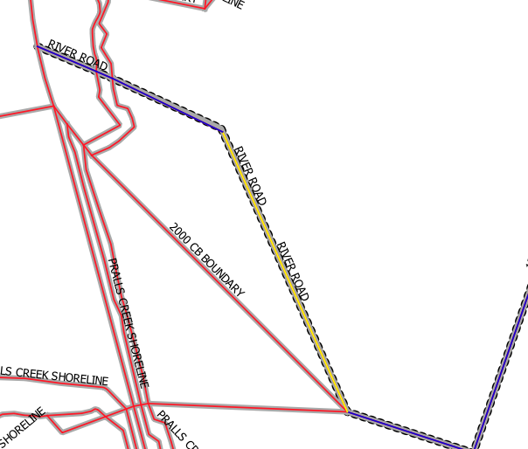
Examples
Possible Gap
River Road used to be 1 segment from the boundary at bottom to the shoreline on the top left; now it’s 2 segments split at the angle.
There was no change recorded for this so the highlighted is actually recorded as a “Possible Gap”
EDIT = ‘conflated’

Slide 11
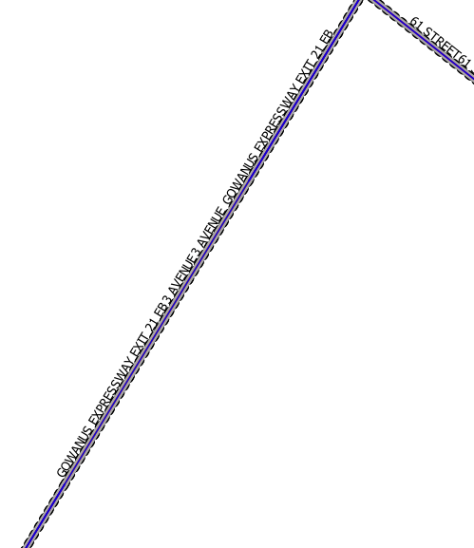
Examples
Old Not Valid
Some issues are caused by LION mistakes
Here 3 Av and Gowanus Expressway share 2D geography but are different elevations; in the old LION rb_layer was “Both” for Gowanus Expwy and “Roadbed” for 3rd Ave
In the New LION the 2 segments wrongfully share the same segmentid!
EDIT = ??

Slide 12
Questions?
Guiding Principles…
Be sure to check 4 shapefiles
old LION
new LION
old target dataset
conflated dataset
Fields to check;
Conflation
Review
feature_typ
segmentID
rb_layer
If you’re not sure, we should talk about it

